Slide 1
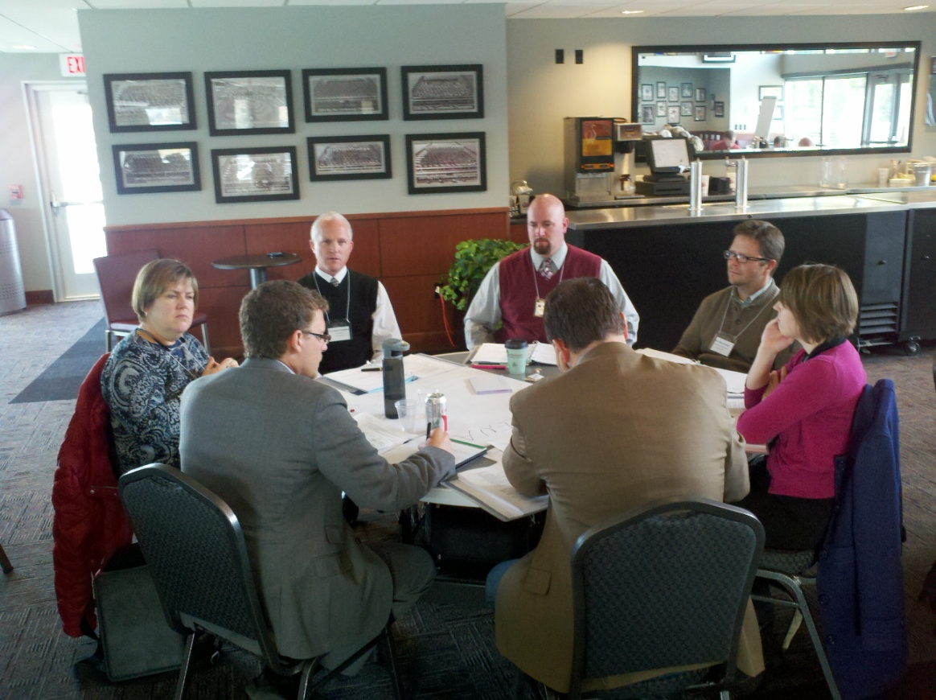
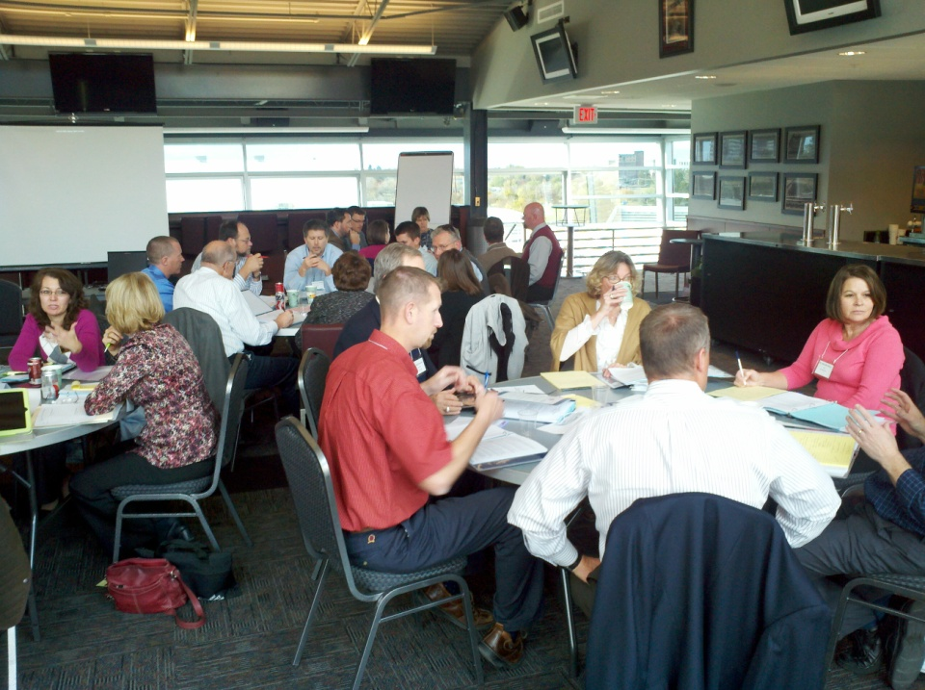
Extending the Comprehensive Mission Update and Next Steps

Slide 2
Montana’s Vision for Two-Year Education
Transform lives and create opportunities through educating the citizens of the state of Montana
Montana University System Website
Notes:
Travelling across the state, we heard from students, faculty and staff, administrators, community members, teachers, and business leaders. In each community, we found a commitment to Montana’s vision of two-year education, where our shared priority is the student.

Slide 3
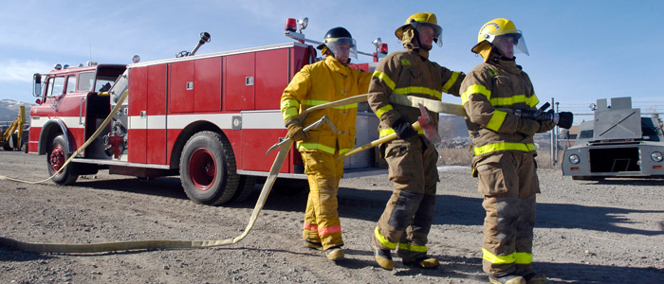
A Brief Look at the Growth of Our COTs

Slide 4
In the past ten years, headcount at the COTs has more than doubled, growing by over 4,800 students. Over the same time period, student FTE increased by 2,936 or 94%.

Slide 7
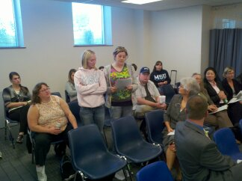
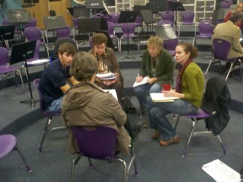
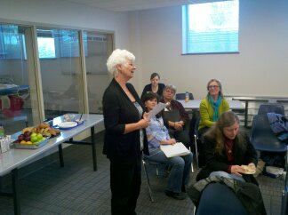
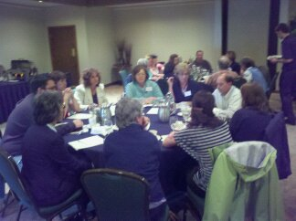
October Listening Sessions Billings, Butte, Great Falls, Helena, & Missoula

Slide 8
Eight General Themes from the College!NOW Listening Sessions
Helena – October 3
Billings – October 5
Missoula – October 13
Butte – October 17
Great Falls – October 19

Slide 9
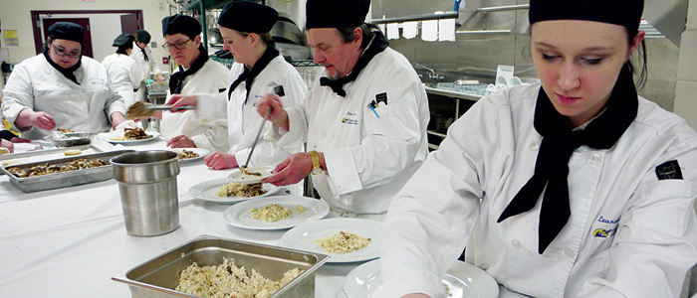
theme 1→ Changing the Organizational Culture
Rebranding Process
Positive Outcomes
Opportunity to promote COTs as affordable access to higher education
Flathead Valley Community College, MUS Website

Slide 10
theme 2→ Importance of Expanding the Comprehensive Mission
University Transfer
Adult-friendly Programming
Developmental Education
Partnerships
Workforce/CTE
MSU-Great Falls COT Website

Slide 11
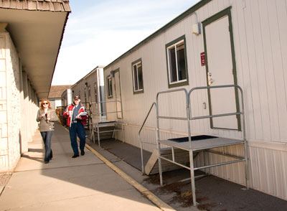
theme 3→ Funding and Facilities
Space
Staffing
Funding
Sustainability
Localized Plan
Missoula Independent article on record enrollment at UM Missoula COT, Feb. 4, 2010

Slide 12
theme 4→ Expanding Services to Support Students
Support Services
Expanded Services
Veterans
Childcare
UM-Helena COT ULEARN Continuing Education

Slide 13
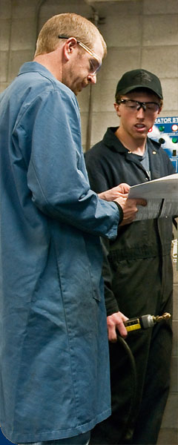
theme 5→ Workforce and Community Connections
Engage Business and Industry
Community Connections
Workforce Development Opportunities
MSU-Billings COT Website

Slide 14
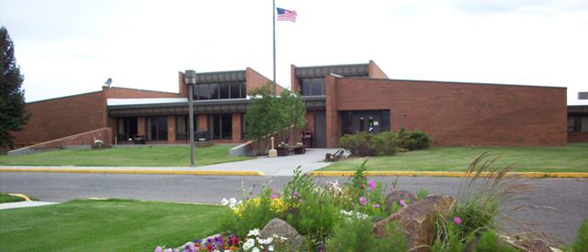
theme 6→ Unique Issues of Embedded COTs
Coordination of Services
Duplication?
Competition?
University Partnership
Affiliation
MT Tech COT

Slide 15
theme 7→ Flexibility and Responsiveness
Reaching New and Different Markets
Rapid Response
Laddering of Programs
UM-Helena COT, Montana University System Website

Slide 16
theme 8→ K-12 Coordination
Pathways
Dual Enrollment
Perceptions and Misperceptions
ABE/GED

Slide 17
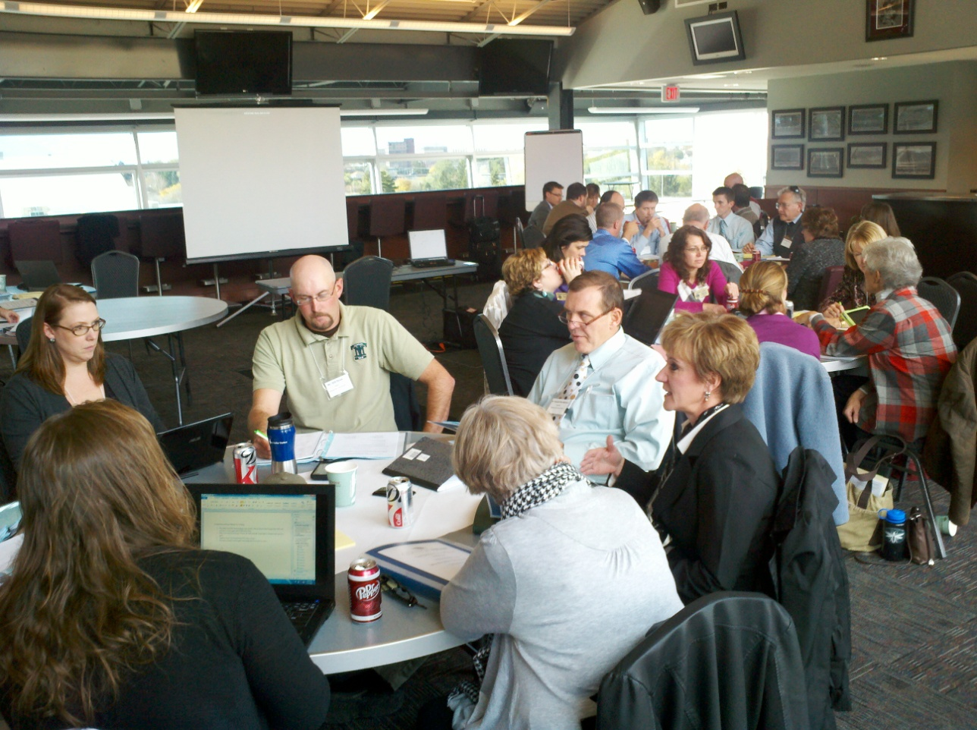
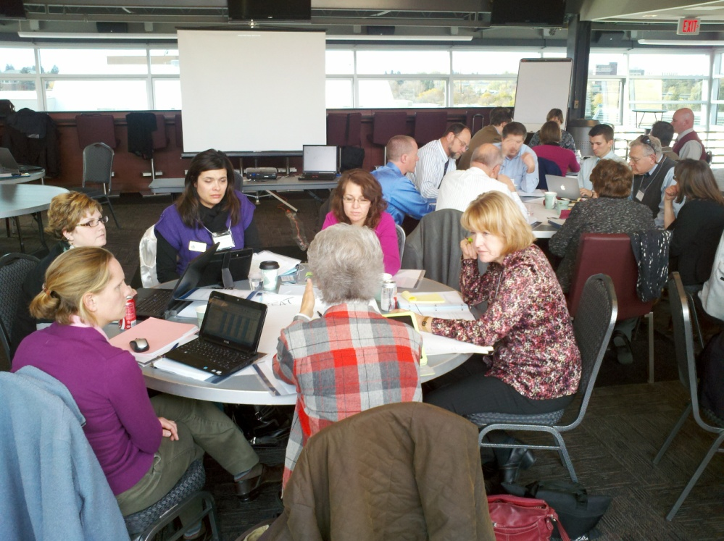
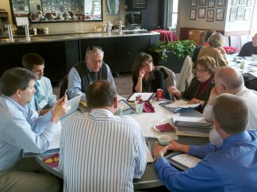
November 3-4 Retreat
Notes:
Travelling across the state, we heard from students, faculty and staff, administrators, community members, teachers, and business leaders. In each community, we found a commitment to Montana’s vision of two-year education, where our shared priority is the student.

Slide 18
Nov 3-4 Retreat→ Outcomes
Comprehensive Mission Planning Process by Campus
Networking/Sharing/Learning
Requests for Additional Consulting Help

Slide 19
Nov 3-4 Retreat→ Outcomes
Creating a “Unified Voice” for 2 year while respecting individual identity
Commitment to Further Engaging Faculty/Staff/Students/Community at each Campus
Stronger Commitment – 2 year/ 4 year

Slide 20
Expanding Strategy #1
Gallatin College Programs (GCP)
MSU Northern’s College of Technical Sciences
UM Western’s Two-Year Programs
Bitterroot College Programs (BCP)

Slide 21
Next Steps→ New Colleges Added to #1
Develop plan to conduct listening sessions
Work with new colleges to develop plans for extending the comprehensive two-year mission
Integrate into December 15/16 Retreat

Slide 22
Dec 15-16→ Retreat
Further Widen the Circle
Focus on Changing the Names/Brand
Discussion of Comprehensive Mission 2012 – 2013 Implementation Plans (per College – Due Dec 9)
(Strategies, Action Steps, Dates, Resources Needed)

Slide 23
Jan 19-20 BOR→ Presentation
Draft Comprehensive Mission Expansion Plans Per COT
Resources Needed as Expansion/Phase In
Initial Rename/Rebrand Concept

Slide 24
Dec - Feb→ Finalizing Comprehensive Mission Expansion Plans
Comprehensive Mission Expansion Plans for each COT Campus
Update on Planning Process for new Colleges added to Strategy #1 in December
Identifying Resource Issues/Needs
Timeline
Creating a Unified Summary

Slide 25
Mar 1-2 BOR→ Agenda Discussion/Action
Presentation of Comprehensive Mission Expansion Plans
Resource Discussion
Rename/Rebrand Recommendation
Action to Approve Plans
Action to Approve New Names/Brand

Slide 26
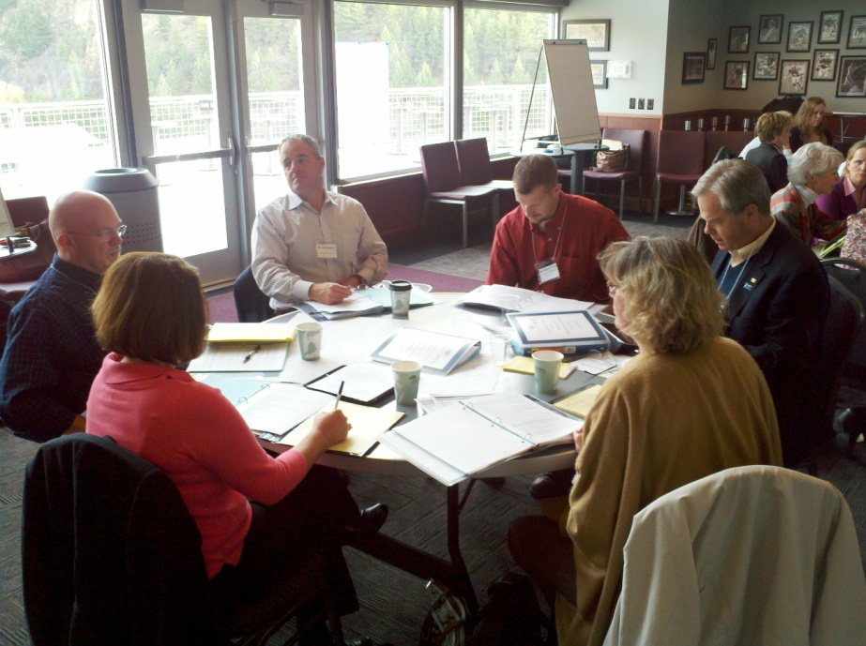
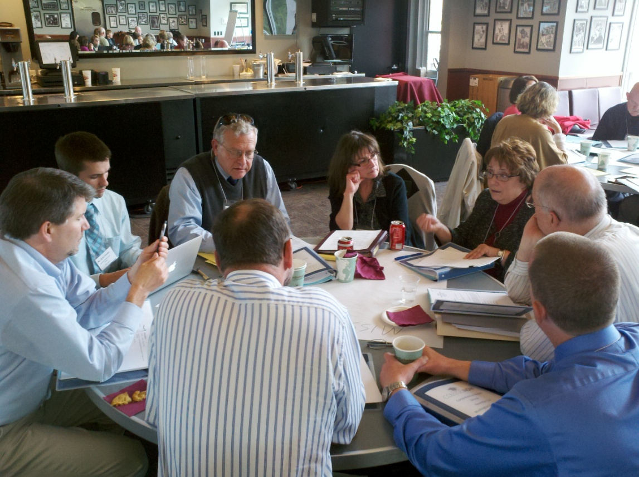
Excellent Progress Was Made – We Need to Move Forward!

